Slide 1
How to write an effective resume

Slide 2

Learning to Market yourself
Sell yourself just as you would sell a product!

Slide 3
Bad resume imagery exercise
Imagine you are a HR manager reviewing resumes for entry level position
What would cause you to throw resumes into garbage or very least into “No” pile?
Spelling Errors
Difficult to Read
Two Lengthy
Unorganized

Slide 4
What Kind?
Many resume samples out there
No one “right” or “perfect” resume
Need to feel good about yours
Provide you with framework

Slide 5
Job Application
It has 2 parts:
Cover Letter
Resume
What is an Applicant Tracking System ( ATS)?
Types of Cover letter:
Solicited
Unsolicited
Networking

Slide 6

WRITINGYOUR COVERLETTERWRITING YOUR COV ERLETTERWRITINGYOUR COVERLETTER WRITIN GYOUR COVERLETTERWRI TINGYOUR COVERLET TER WRITINGYOUR COVERLETTER
WRITINGYOURCOVERLETTER
PRESENTATION OVERVIEW
WRITING THE PERFECT COVER LETTER
What is a cover letter?
What is the purpose of cover letters?
Business formatting
Paragraph by paragraph
Things to keep in mind

Slide 7

WHAT IS A COVER LETTER?
A COMPLEMENT TO YOUR RESUME
Cover letters are a narrative complement to your resume.
A brief one page document that helps expand on the experiences you showcased in your resume.
Highlights your motivations in applying for the position and why you want to work with this specific organization.
Showcases your personality and values.
Notes:
Back when we mailed in paper resumes, the cover letters introduced the candidate and shared the position for which they were applying. Though we can do this in a subject line nowadays or maybe we are uploading our resume into an application system, cover letters are an excellent way to add depth to our application while also demonstrating our written communication skills. They also show a bit of personality and values in the writing style, word selection, and topics a candidate chooses to discuss.

Slide 8

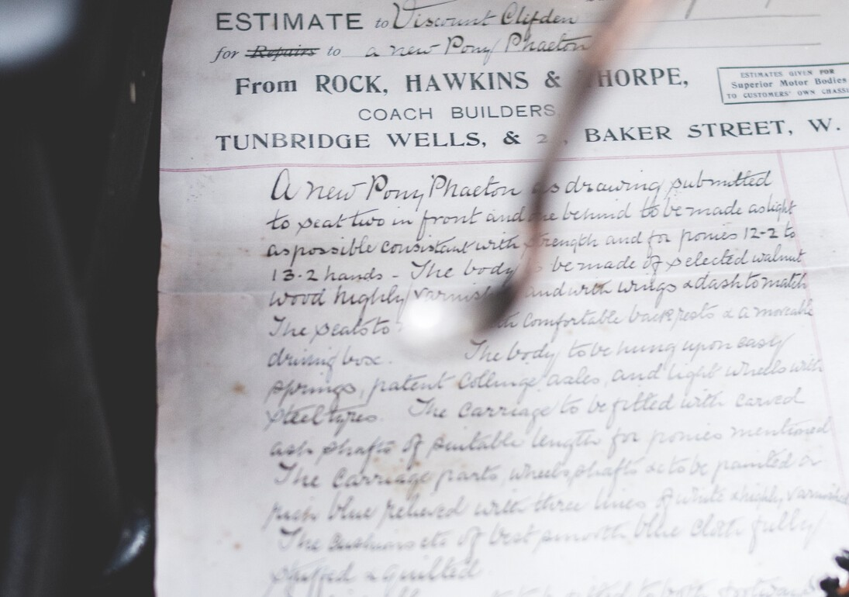
PURPOSE OF A COVER LETTER
Cover letters should highlight your academic, professional, and personal qualifications for the position to which you are applying.
It should not be a restatement of your resume
Instead you should select certain experiences to highlight to the employer.
You might tell a story from one or two experiences that bring depth and detail not covered in your resume.
Notes:
Typically, a reviewer will read the resume first and then come back to the resume and cover letter if they are interested. They can hold more weight in certain fields and positions, especially ones where written communication is important. Cover letters shouldn’t be a list of everything on their resume but instead it is used to TELL THEIR STORY. Students might talk about how they became interested in this field: growing up vising national parks and that sparked their interest in forestry, perhaps they had a family member struggling with addiction and that led to their passion for social work, or maybe they grew up tinkering with computers and have turned it into a career field. Also, maybe they knew they wanted to study philosophy and a guest speaker sparked an interest in medical ethics which led to a summer internship in the field or their engineering curriculum included classes on rapid tooling and prototyping with hands on projects. They might go into detail on a specific experience such as tutoring a third grader in reading and the challenges and successes they faced, or a time they lead a group project for a class as a way to demonstrate their leadership style. These stories bring out their work characteristics, values, and personality, which is what makes them stand out as an individual.

Slide 9

PURPOSE OF A COVER LETTER
A compelling cover letter answers "Why you?" and "Why them?"
Why you: Focus their attention on your most relevant and compelling qualifications. What value will you bring to the organization? (Not what you want or what you can gain.)
Why them: Be sure to include a sentence on why you want to work with this particular organization.
Talk about them. Be sure to match your tone to the organization, i.e. corporate banking tends to be more formal than marketing or nursing. (Don’t confuse formal with professional. All letters should be written with a professional voice and focus.
Do not use slang, abbreviations, or a casual tone.
Cover letters that are just about you are dry and expected. To catch their attention, MAKE A CONNECTION.
Notes:
In addition to telling stories about themselves, students MUST include why they want to work for this particular organization. Sometimes students are applying for dream organizations (just talk with any student applying to the Disney program or NASA!) but sometimes the equation is pretty simple – the student wants to work in finance and this company has a position that aligns with their qualifications. Not every job is the dream and not every person has a desire to feel passionate about their job and workplace, that’s okay. However, they still want to include at least a sentence that demonstrates that this letter was tailored to this letter was targeted for that particular organization and that the students has done a little research to learn about their organization.

Slide 10
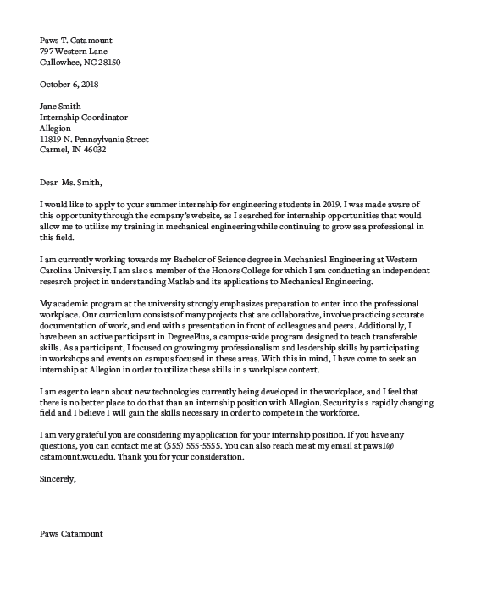
Your Name Your Address Today’s Date Their Name Their Title Their Organization Their Address Greeting, Introduction Paragraph Body Paragraph(s) Closing Paragraph Subscription Your Name
TRADITIONAL Business Formatting
Notes:
Review of business formatting – many students have not used this previously so it’s good to show and walk through in detail.
NOTE: This is a very traditional format. Styles can differ based on career field or company. When it doubt, we encourage students to be more formal and traditional in their presentation and only use something more creative if they know it is a good fit for the organization. If you are working with students in a particular academic discipline or industry, and know that a different style is preferred, please update this slide or point out the distinctions. For example, less traditional/formal organizations and creative companies often like to see a branded header that matches the resume. Some industries prefer a bullet pointed letter that makes a quick connection between skills and experiences sought and the candidates.

Slide 11
HEADER AND GREETING
PAWS T. CATAMOUNT
797 Western Lane
Cullowhee, NC 28723
OCTOBER 6TH, 2020
JANE SMITH
Internship Coordinator
Allegion Corporation
11819 N. Pennsylvania Street
Carmel, IN 46032
Dear Ms. Smith,
Notes:
Again, students can choose to use this style header for their contact information OR they could use the same header as their resume.
Students are encouraged to find a name to address the letter to if at all possible. They can look at the company staff paged, use LinkedIn, google, etc. Doing this research is a great way to demonstrate their willingness to do a little extra when needed. If they can’t find a name, they can leave it blank and simply use the name of the organization and the mailing address (more on this in the video on slide 13).

Slide 12
Paragraph by Paragraph
OPENING PARAGRAPH
State the position to which you're applying, where you found it/heard about it, name drop if you have a direct connection, and close with a ‘hook’.
ACADEMIC INTRODUCTION
(Used if you are applying for something related to your major)
State the college you are attending, your degree, relevant classes you’ve completed, and other relevant academic information.
BODY PARAGRAPH
Connect your skills, characteristics, experiences, and qualifications to the position and company as a whole.
Highlight what interests you in working with this particular organization.
CONCLUSION AND FORMAL CLOSING
Reaffirm your qualifications and interest in the position and company. Be sure to include your contact information. Could offer to follow up with the employer. End the letter formally.
Notes:
Opening – always state the name of the position, organization, and where they found the job/internship/fellowship. If they have a connection, they should name it in this paragraph (my former supervisor, Keiara Osborne, who now works with this organization or one of your accountants, Tucker McFarland or my professor, Dr. Lily Rodriguez, sent me this opening…and encouraged me to apply). The hook is a brief sentence or two about their interest in the organization and a little about their background to catch the employers attention.
Academic introduction – Not every opportunity students apply to are directly connected to their major. This information is only necessary if students want to highlight this information in connection to the position.
Conclusion – Students can offer to follow up with the employer by stating something like, “I will follow up in one week to ensure you’ve received my materials.” or (more assertive) “I will follow up in one week to inquire about scheduling an interview.” This is optional and should NOT be used if the posting says “no phone calls/emails.” If a student includes this in this letter, they must be sure to follow up on the noted date.

Slide 13
What is a resume?
A resume is a SUMMARY of one’s education, work history, volunteer experience, organizations, activities, honors/awards
First impression of you for employer - Wow Factor
Commercial and not documentary - Grab employer’s attention;
Marketing Tool
- Convey how you can contribute positively to company
- Resume should show potential to do quality work so free from errors
Notes:
Marketing Tool (first point)
Wow factor! (2nd point)
Purpose
Not historical record- keep it brief ------ But how brief? (3rd point)

Slide 14
Purpose of a resume is….?
To get an interview not a job!!!!
A good Resume gets you a foot in the door, its up to your to sell yourself in person!

Slide 15
How Long?
Employers spend less than 2 minutes reviewing resume (some less than 30 secs)
Search for key words or information to show fit with the position
More is not always better
Content needs to be relevant
Notes:
1-2 pages in length based upon discipline

Slide 16
Why now?
Immediate needs of employers
Future considerations (internships, full-time jobs, or graduate/professional schools)
Fresh in our minds
Notes:
Resume is dynamic changing document
Update after each semester

Slide 17
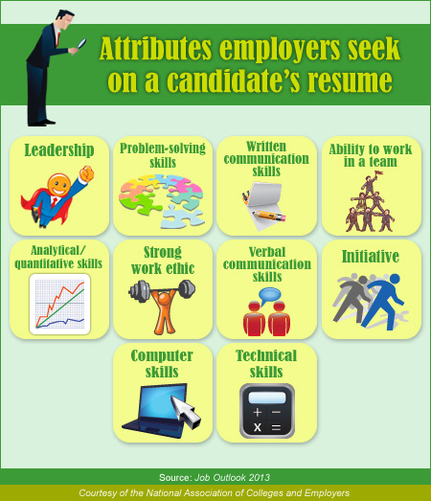

Slide 18
Resume Do’s!
Contain an Objective Statement
Customizable for each job
Pleasing to the Eye, Easy to Read!
Lists skills, employers want to know what you can bring to their company.
Relevant to the Job. It should fit with the job you are applying for.

Slide 19
Do’s Continued
Keep your resume to 1-2 pages
List education and work experience in reverse chronological order
Put your resume, cover letter, and references on professional style resume paper
Proofread
Have your resume critiqued by a Career Service professional or employer
Make it relevant and focus on skills/accomplishments

Slide 20
It’s Simple- Show, Not just tell
The following is from the resume of an applicant for an operations position in a toy company:
Managed eight reindeer.
Managed eight reindeer to distribute toys around the globe.
Increased 2009 global gift distribution 60% by successfully hiring, training, and managing eight reindeer to distribute toys around the globe.
Adapted from 5 Resume Tips for Executives & Entrepreneurs by Blythe Grossberg, NAFE E-Newsletter (2005)
Notes:
Instead of telling your audience “I’m a good communicator” or “I have strong analytical skills,” show your skills with real data. The following statement is from the resume of an applicant for an operations positions in a toy company:
Managed eight reindeer
Here’s how to make the statement results-oriented:
Managed eight reindeer to distribute toys around the globe.
Or better still . . .
Increased 2005 global gift distribution 60% by successfully hiring, training, and managing eight reindeer to distribute toys around the globe.
The final statement is not too lengthy; remember it’s the facts that set the candidate apart.

Slide 21
Resume Don'ts!
Grammatical and spelling errors
Unprofessional (check your email address)
Too much info (overly wordy)
Irrelevant information
No objective statement
Lengthy paragraphs
Personal information
Leave a large amount of white space
Notes:
Refer to employer survey
No staples, folded, salary history, and do not lie or exaggerate

Slide 22
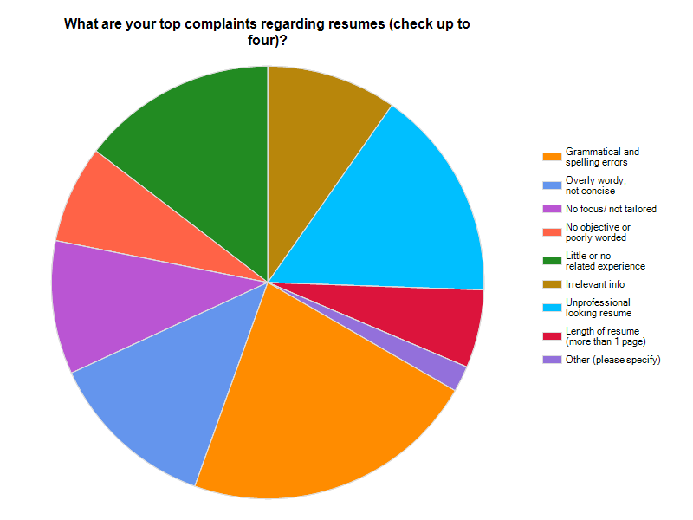
Resume complaints

Slide 23
Resume Odds and Ends
Font sizes and styles Margins Leave spaces between headings on resume
Most important to least important PROOFREAD

Slide 24
Resume Sections- Demographic Info
Name
Address
Phone
Email
Albert Einstein_____________
12 Smart Way * Boston, MA 32475
OR
Albert Einstein
12 Smart Way
Boston, MA 32475
E=mcsquared@genius.com
Notes:
Name in larger font and bolded
Speak about professionalism with phone and email

Slide 25
Sample Objectives
Good
Bad
To obtain a position as an accountant
To obtain a position as an accountant in the automotive industry utilizing my strong analytical and problem solving skills
To find a challenging position with a growing company that will provide me with relevant experience in an exciting field
Notes:
Recruiter is trying to fill position not look for you a job

Slide 26
Summary of Qualifications
Brief synopsis of most relevant skills and experiences
Craft carefully and match to job being sought
No set number of points (4-8)

Slide 27
Resume Sections-Education
Degree
Graduation date
College or University
Location
Minors
GPA
Notes:
List degree first and graduation date over years you attended
Employer focus- want to know when you are available and what type of degree

Slide 28
Resume Sections- Experience
Job title
Dates of employment
Employer
Location
List jobs with most recent first
Don’t list employer address or supervisor
(This type of information may be required on a job application though.)
Notes:
May have more than one section (relevant or other term and other)
Remember marketing tool
Other resume styles (Functional and Combination)

Slide 29
Experience Con’t
Be sure to include duties, skills learned, and accomplishments
No set number of bullets to use
Avoid “I” statements
Begin with action verb
Notes:
Look at past job descriptions as a guide
Use your objective statement to help focus the info you put under each position

Slide 30
Resume Sections- Other
Certifications/Licenses
Computer or technical skills
Honors/Awards
Volunteer Experience
Extra-curricular activities
Professional organizations
Professional development
Presentations
Military Service
* Only list things relevant to the job.
Notes:
Show positions of leadership if possible
Avoid controversial information

Slide 31
References
Separate page
Include full contact information
Ask first
Three to five
Contact info at top
Put on high quality professional paper
Notes:
When to send- when asked or with resume 2 schools of thought

Slide 32
Questions??????
A special thanks to Kevin Allan Director of Career and Testing Services at University of Mary for information included in this PowerPoint, and DePaul Universities Career Center for the Resume examples.

